Slide 1
Fetal Distress Classification Based On Cardiotocography
Group 13

Slide 2
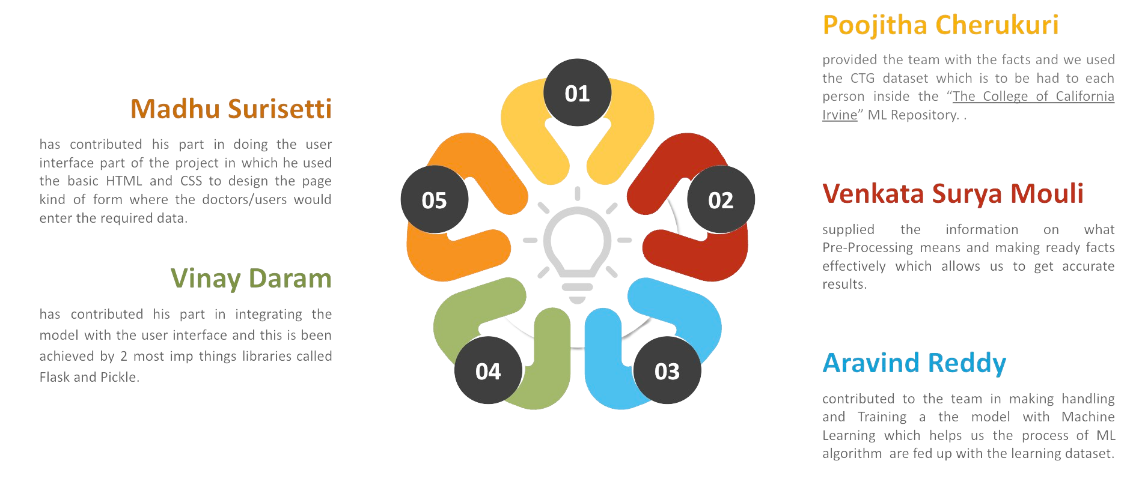
Our Team Layout

Slide 3
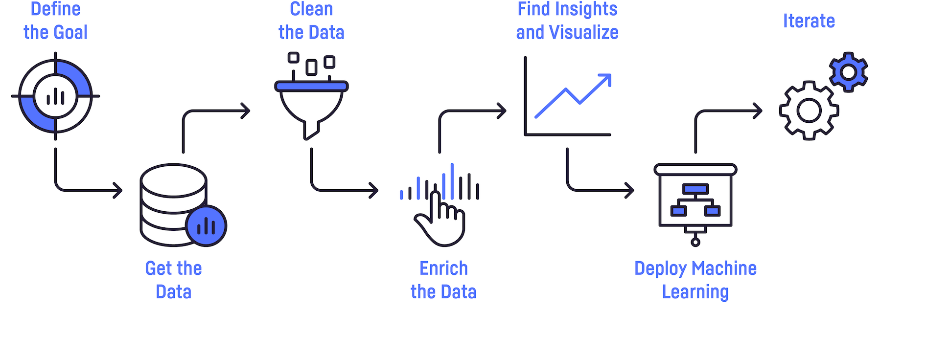
Workflow which we used

Slide 4
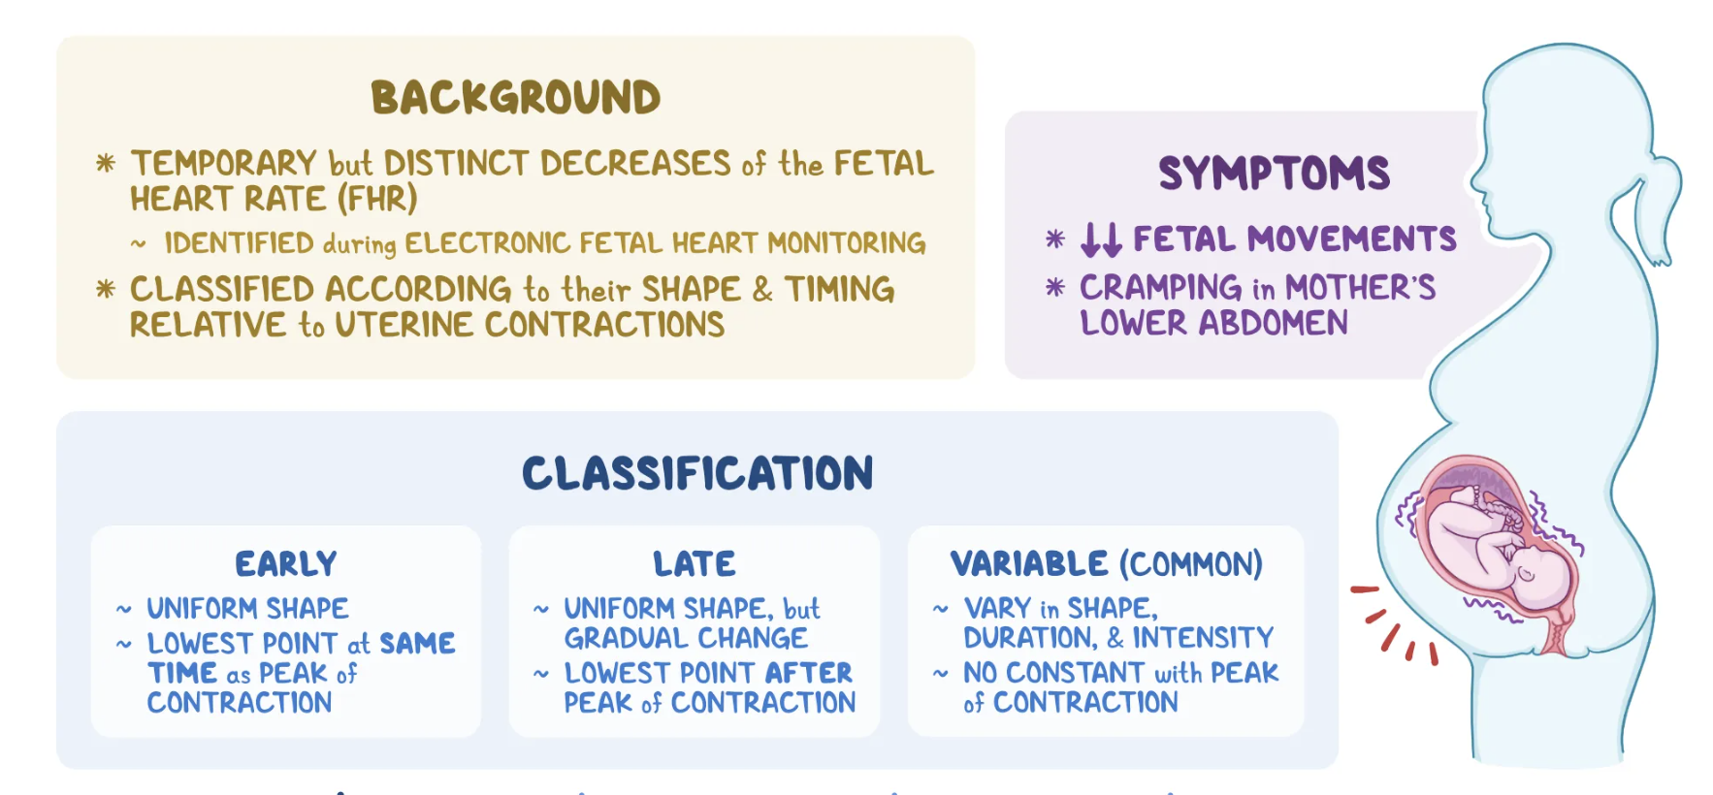
Abstract
The fact that kids are the destiny of the sector. So, workers need to ensure that they're born with no complications or disabilities. but unfortunately, some toddlers are born with one or greater complications and certainly one of those is fetus misery. This situation happens because of insufficient oxygen supply and lots of different factors in the mother's womb. This misery will result in a few disorders like neurological malfunctions and every so often it may also lead to demise. Cardiotocography (CTG) is an effective, efficient, and widely used technique to research the fetal heartbeat price (FHR) and uterine contraction of the mom, and so forth.
PowerPoint Presentation

Slide 5
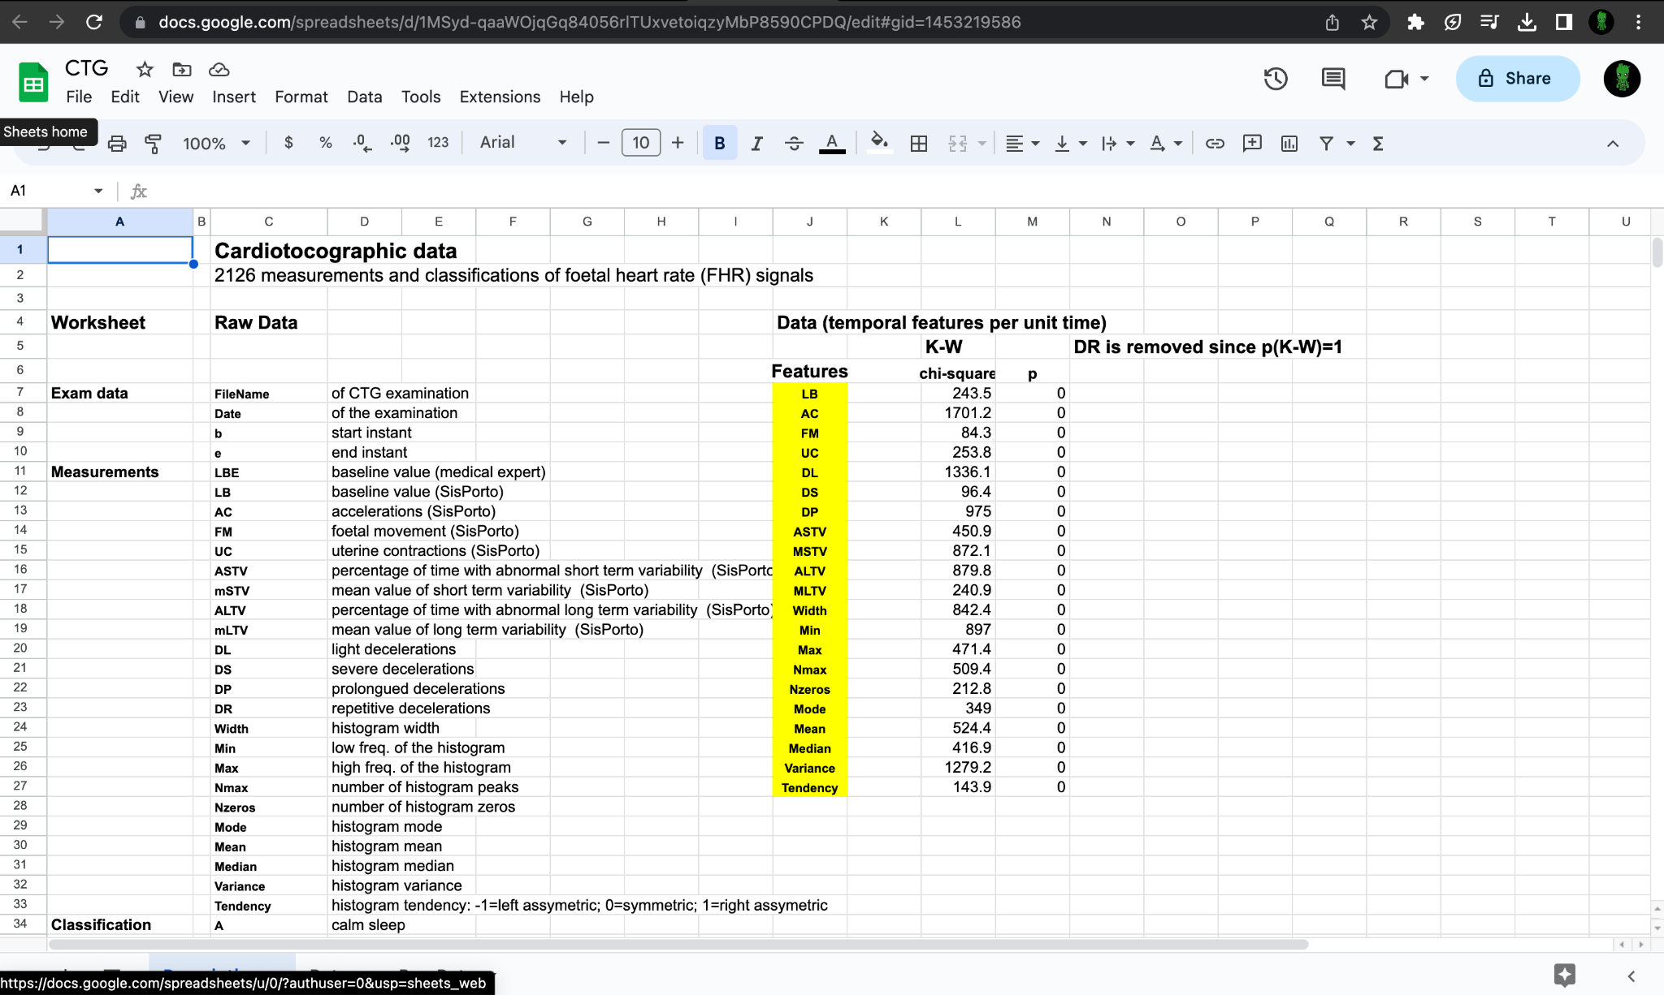
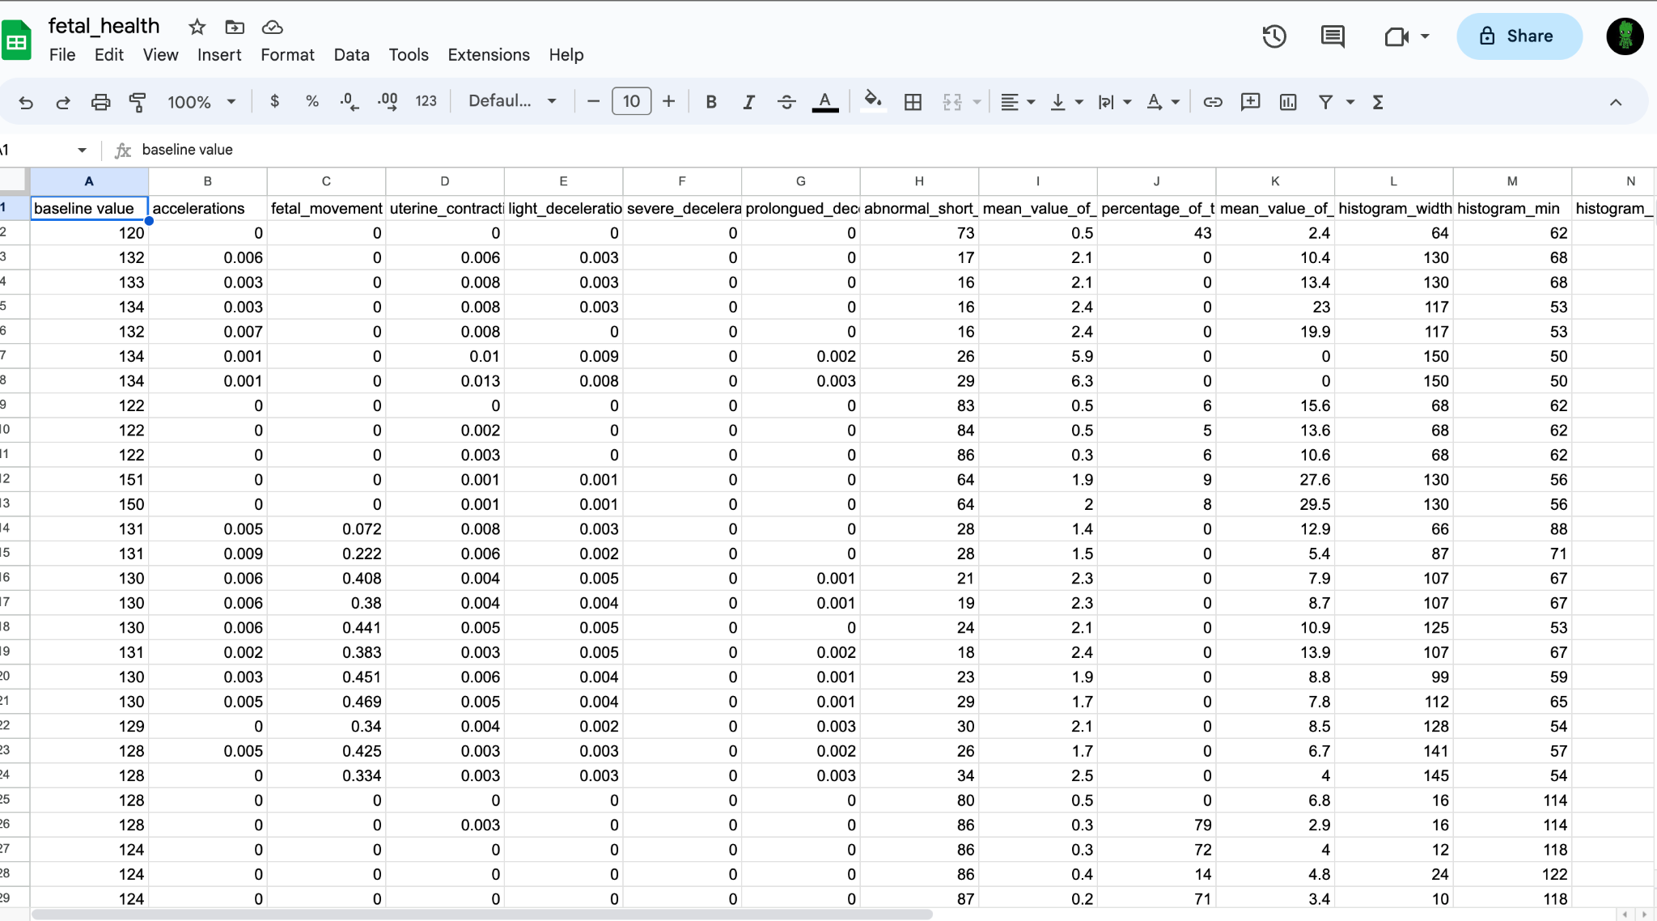
Describing Data
Old Data
New Data
The data which we get form the sources of college of california
By using some preprocessing techniques and other analizes we will preprocess the data into the following format
CTG dataset which is to be had to each person inside the “The College of California Irvine” ML Repository. The dataset carries 21 Columns except for the goal class. using those functions of facts must classify the fame of the fetal nation.

Slide 6
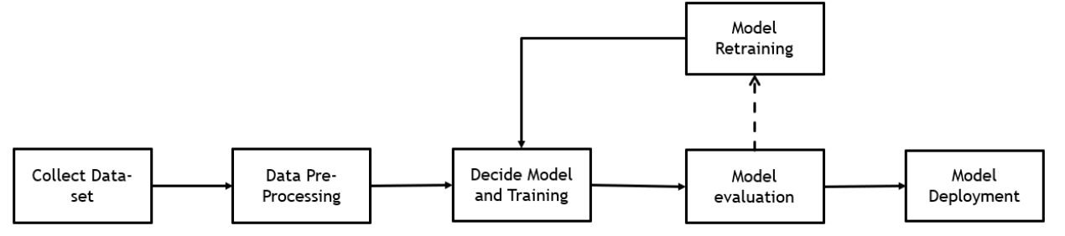
Project Design
Project Design is the first phase of the project. A Project Design is a strategic combination of features and processes to achieve a goal. Project Design helps a group or team to achieve a goal in the step-by-step process. The below diagram represents the design of the project

Slide 7
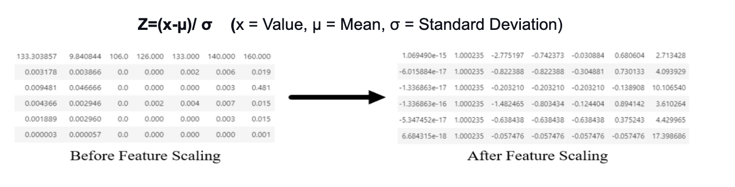
Data Pre-Processing
Pre-Processing means preparing statistics efficiently which enables us to get accurate results. The crucial step in preprocessing is dealing with missing values, disposing of unwanted features, and transforming the statistics within the dataset.
Feature Scaling:
It is a method that is used to standardize the characteristic values present inside the dataset from long variety to small. In this examination, we used the standard Scalar process for feature Scaling.

Slide 8
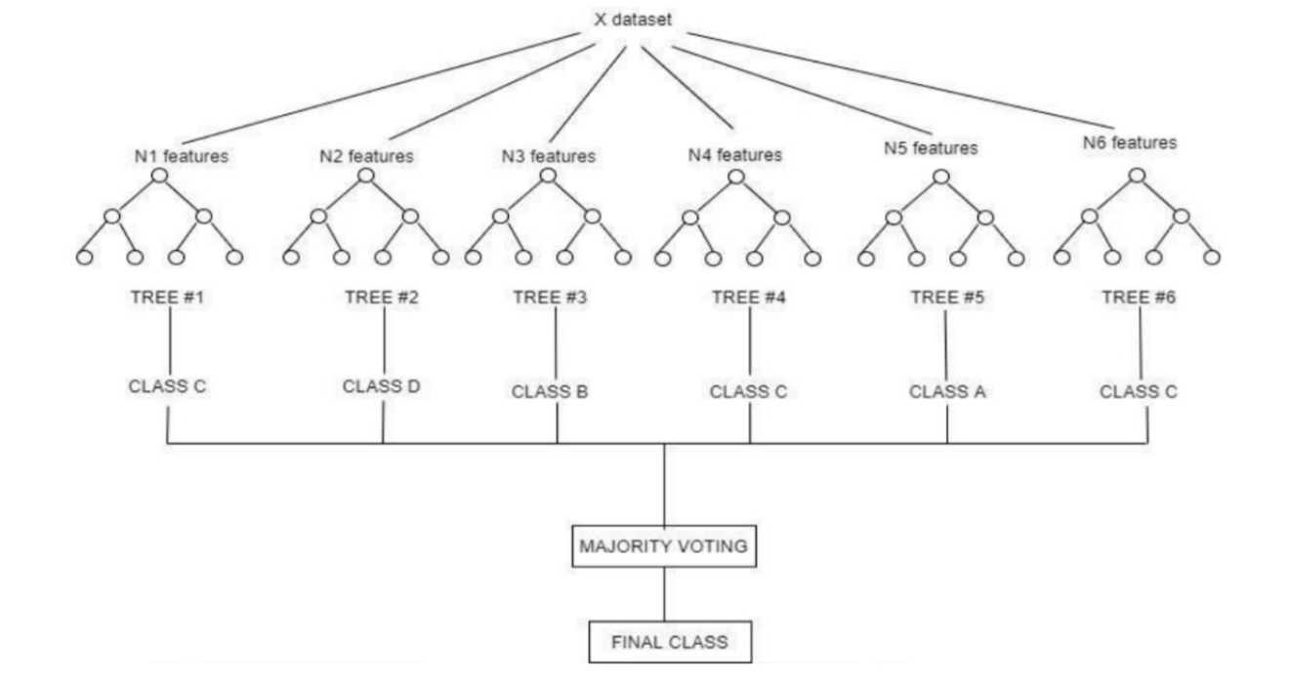
Model Training
Handling and schooling a device studying model is a process in which the ML algorithms are bored to death with the learning dataset. We used the deployed model for new information to predict the outcome.
Random Forest:
Random Forest is one of the ensemble ML methods. RF algorithm can be used for both Classification and Regression. In this study, we are using Classification Algorithm because of the dataset in the categorical distribution.

Slide 9
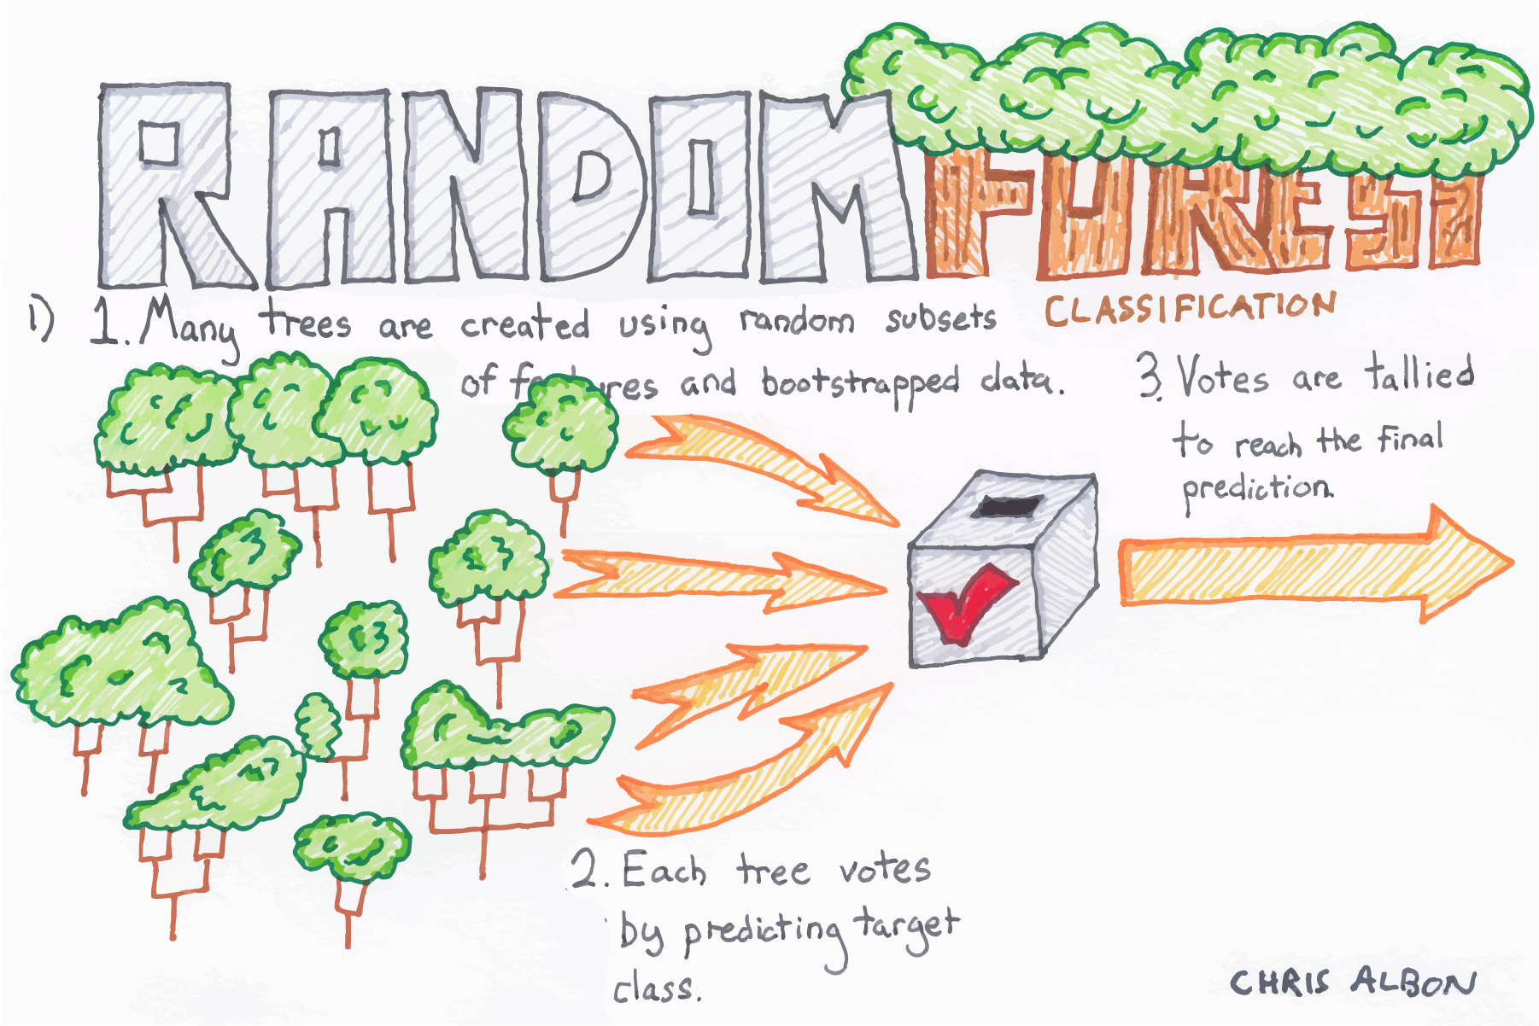
70%
You can simply impress your audience and add a unique zing.
80%
Why we used Random Forest ?
You can simply impress your audience and add a unique zing.
50%
You can simply impress your audience and add a unique zing.

Slide 10
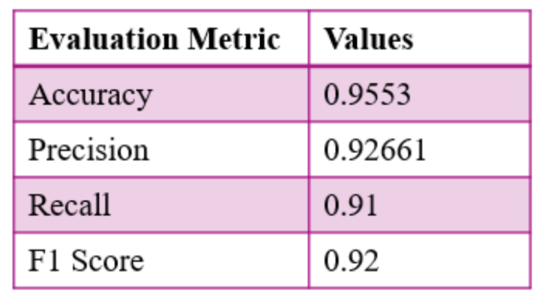
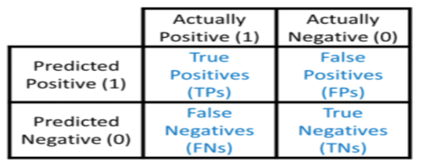
Performance Evaluation
Performance Evaluation is the important step in Machine Learning Model. The main aim of the model evaluation to estimate the accuracy of the model on unseen data. There are various types of metrics which we can use them to evaluate the performance of the Machine Learning Model
Random Forest:
The Model Accuracy is about 95~% (approx.) that we achieved by apply the testing data on model. Precision refers to the quality of model. Here, model’s precision based on test data is about 93~% (approx.) which means that random forest predicting 93% more relevant results than irrelevant.

Slide 11

Feature Scope
As a part of Feature Scope, we are planning to improve our model by using other algorithms like Gradient Boosting, Extended Trees, and other models and taking the high voted value from those results
We are also planning to build a User Interface which helps doctors and other users to use this in a much easy way

Slide 12
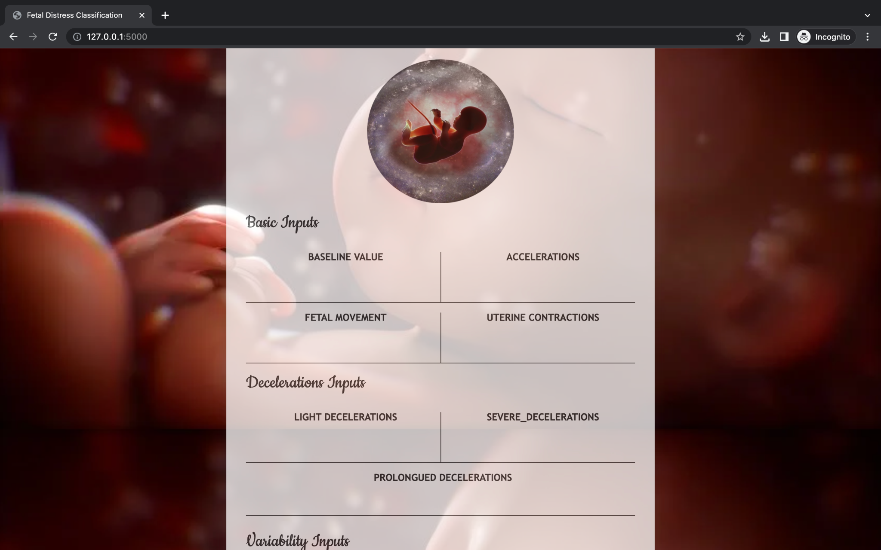
Deployment with User Interface
User interface part of the project in which he used the basic HTML and CSS to design the page kind of form where the doctors/users would enter the required data and then after entering this would go to a flask model which comes in the integration step then we would get the results page where we use to display the result, required graphs which would help the doctors what steps need to be done and medication as well.

Slide 13
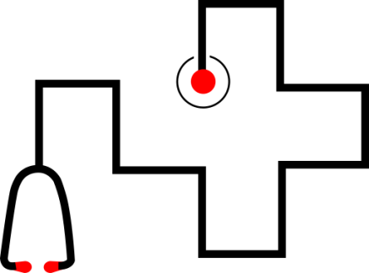
References Used
01
Warrick PA et al. A Machine Learning Approach to Detection of Fetal Hypoxia during Labor.
02
Ocak, H., Ertunc, H.M. Prediction of fetal state from the cardiotocography recordings using adaptive neuro-fuzzy inference systems.
03
J, Thamil Selvi V, Aishwarya Investigation and Classification of Cardiotocography Data using Correlation Coefficient and PCA based Features

Slide 14
Thank you

